Slide 1
Santander Customer Transaction Prediction Report
Ravi Shankar Vats

Slide 2
Agenda
Solution
Interesting Findings

Slide 3
Solution
As we share our solution is quite simple
remove fake from test
concat train and test, and then reverse half of features
standard scaling
count encoding
count round encoding
unpivot all vars(so we have 200k x 200 = 4m train samples)
train and predict(LGB and NN)
convert prediction(200k x 200) into odds. We used (9 * p / (1 - p)).
blend LGB:NN = 1:3

Slide 4
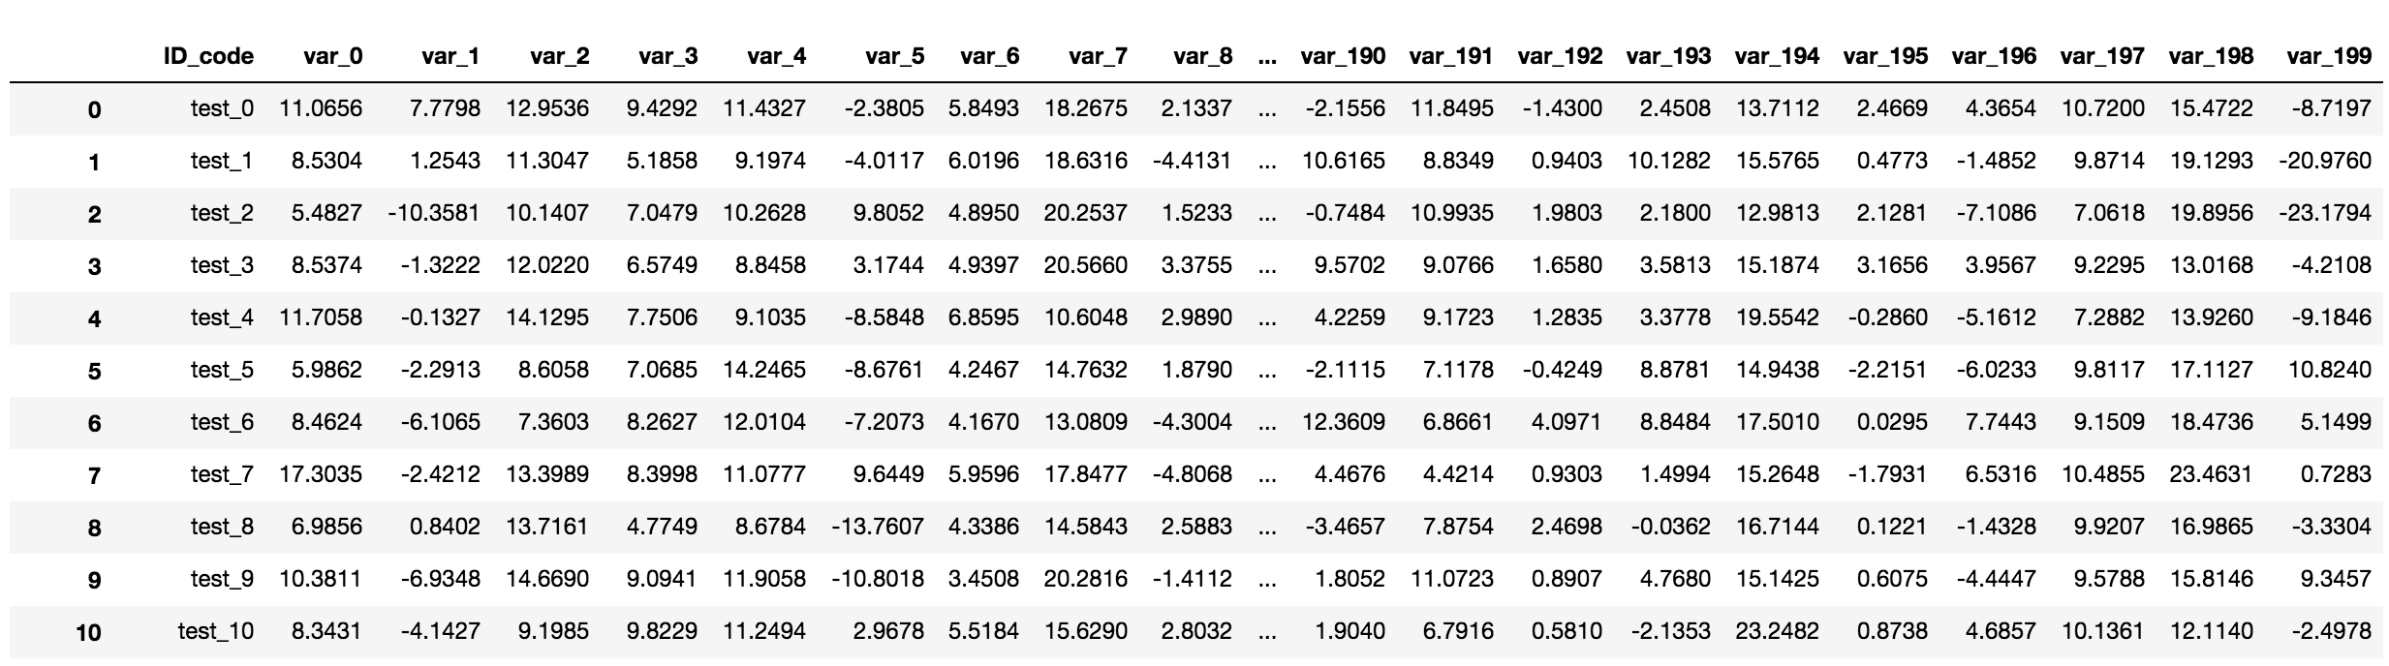
Solution
remove fake from test
According to this kernel , we do know which sample is fake exactly.
remove

Slide 5
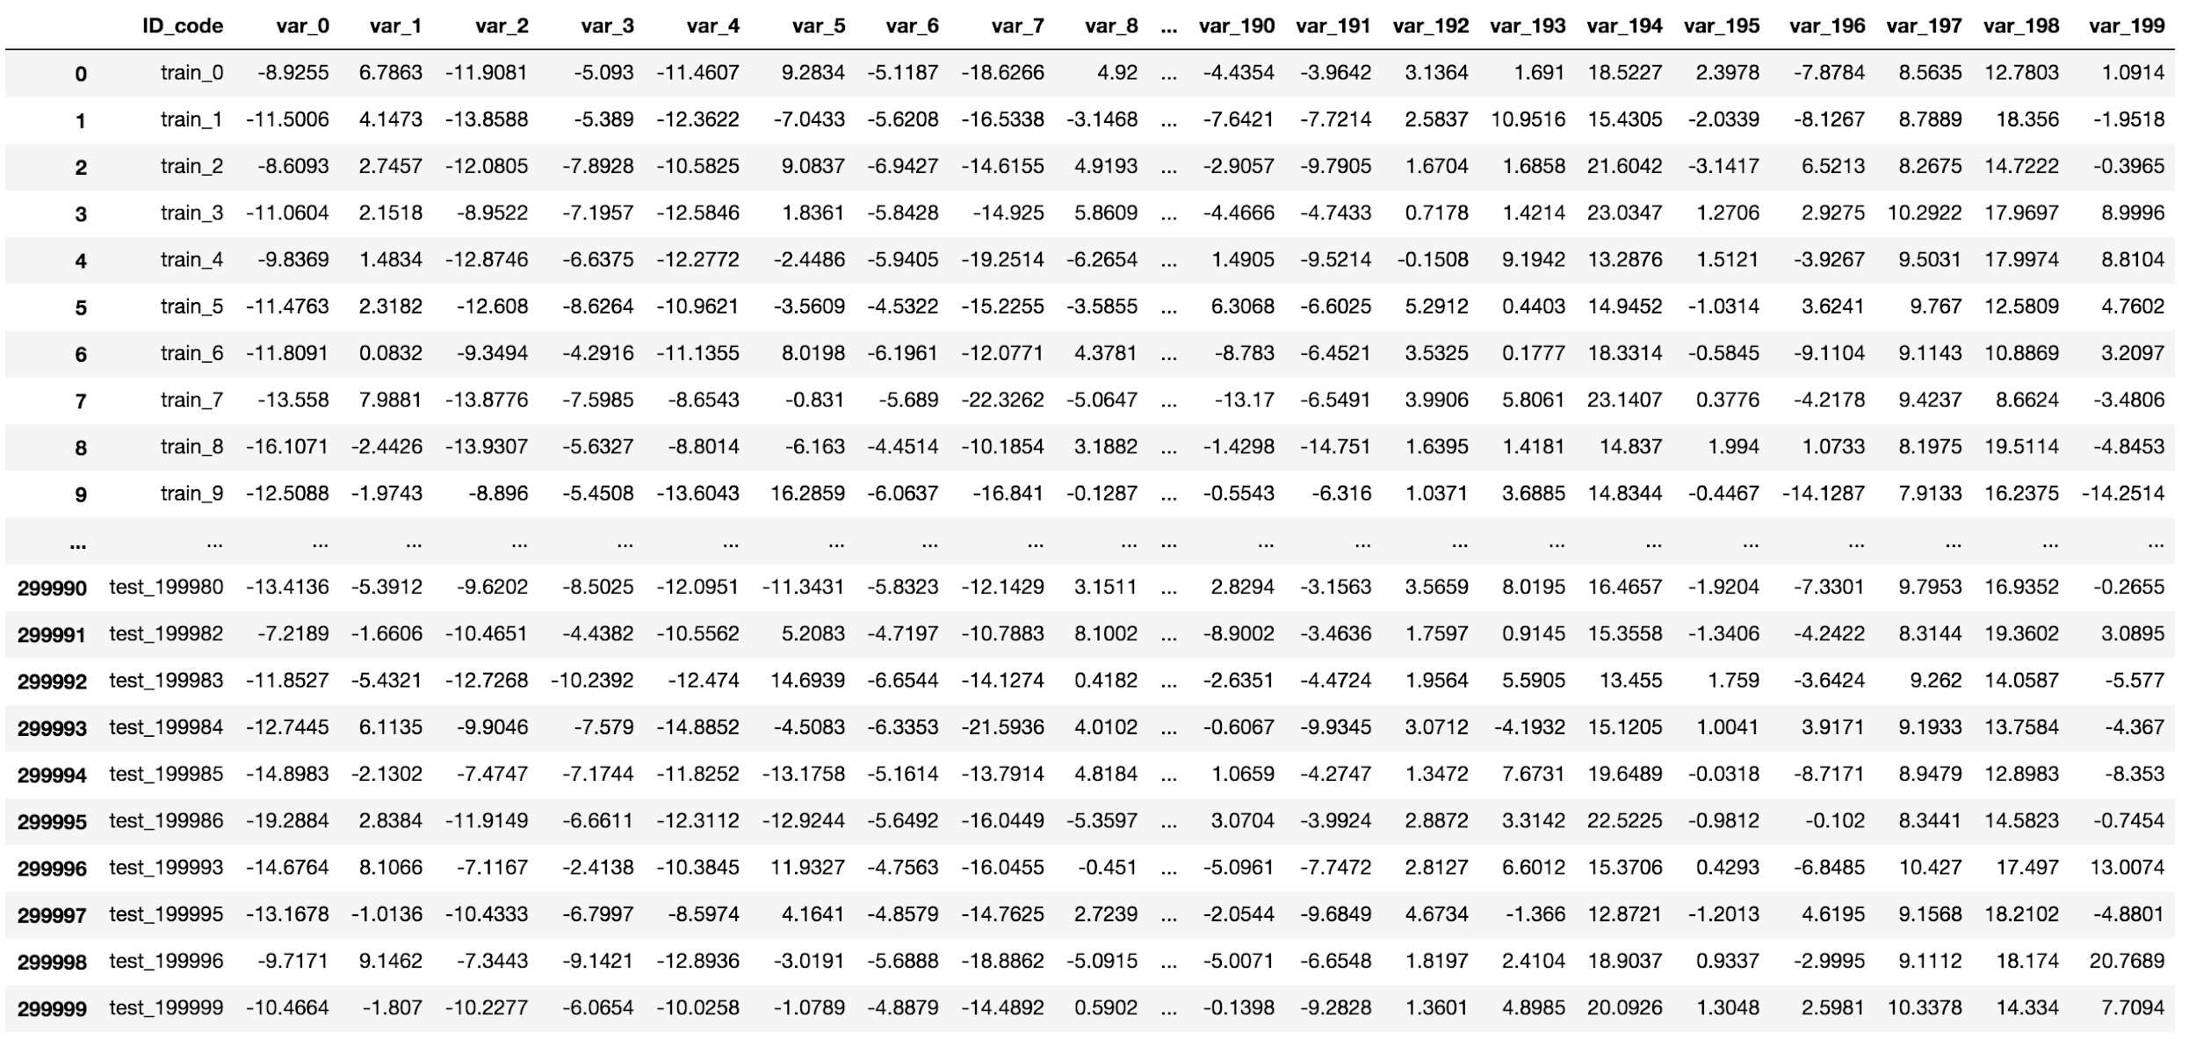
(more specific)
Solution
concat train and test, and then reverse half of features
refer to this Kernel

Slide 6
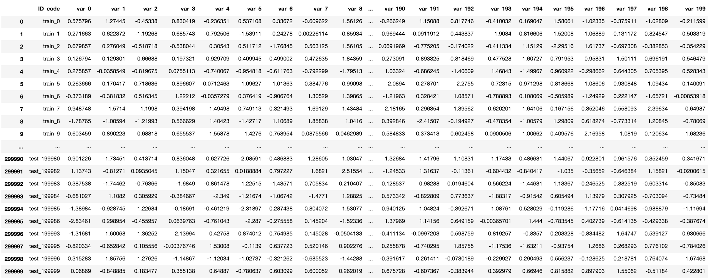
(more specific)
Solution
standard scaling

Slide 7
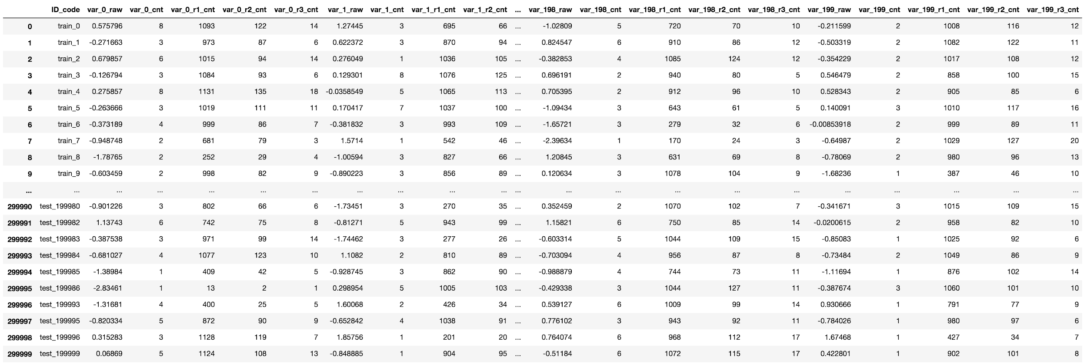
(more specific)
Solution
count encoding
count round encoding

Slide 8
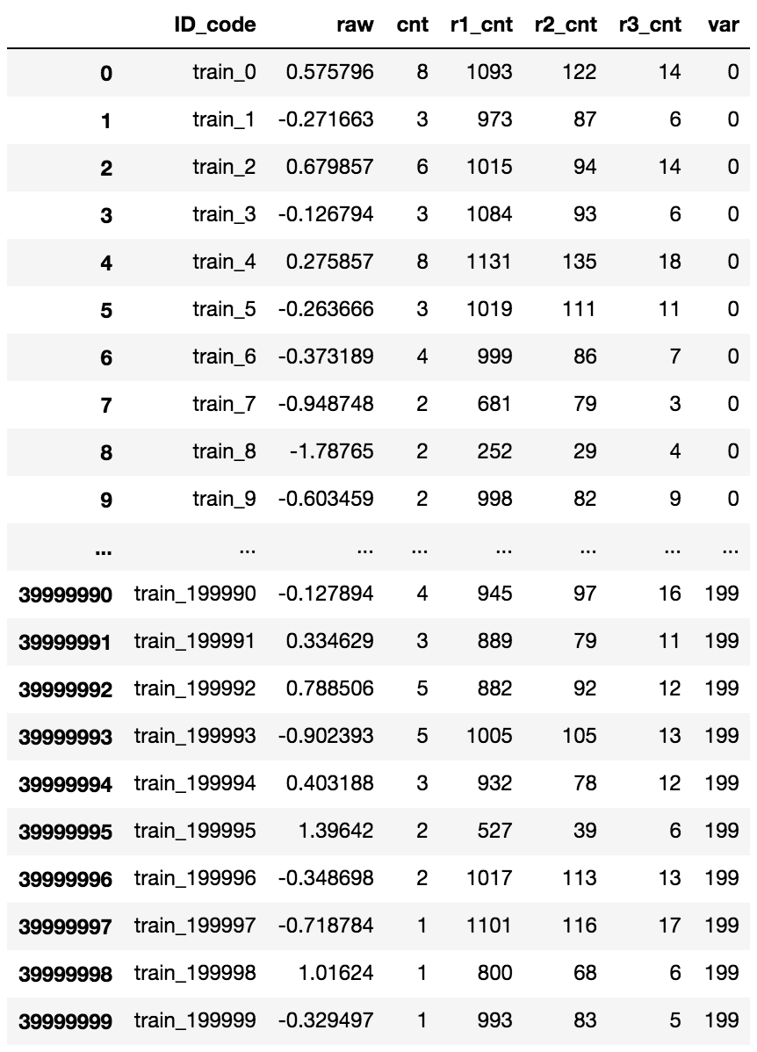
Solution
(more specific)
unpivot all vars(so we have 200k x 200 = 4m train samples)

Slide 9
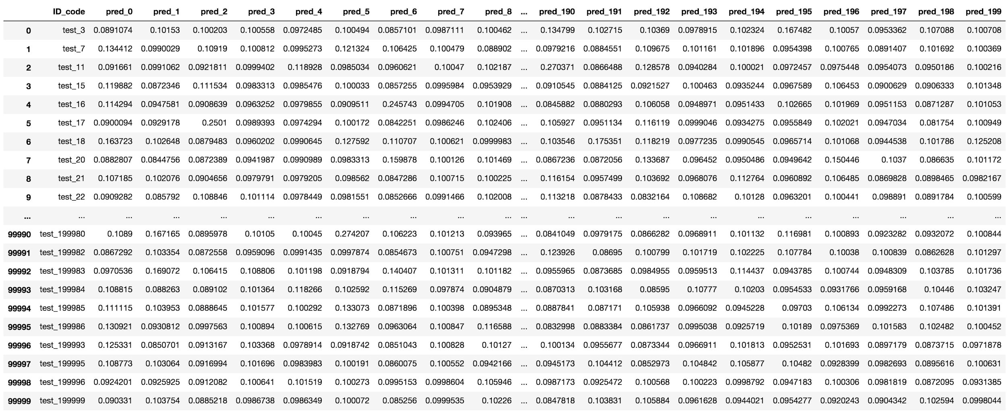
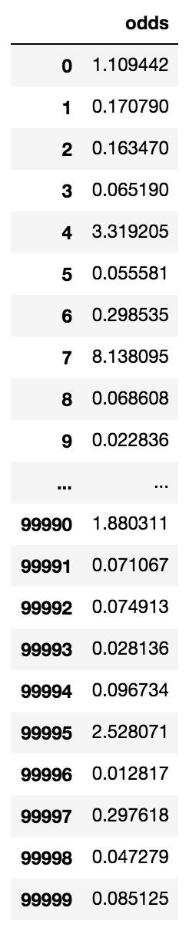
(more specific)
Solution
train and predict(LGB and NN)
convert prediction(200k x 200) into odds. We used (9 * p / (1 - p)).

Slide 10
Interesting Findings
Removing fake samples is the key of this competition
CountEncoding works even if continuous variable
After scaling, we can handle each var as same var. Unpivot works.
NN is better than LGB
 | Public | Private
LGB | 0.92563 | 0.92436
NN | 0.92640 | 0.92547
LGB:NN=1:1 | 0.92645 | 0.92535
LGB:NN=1:3(our best) | 0.92653 | 0.92552

Slide 11
Thanks

